Slide 1
Project management
Millstone

Slide 2
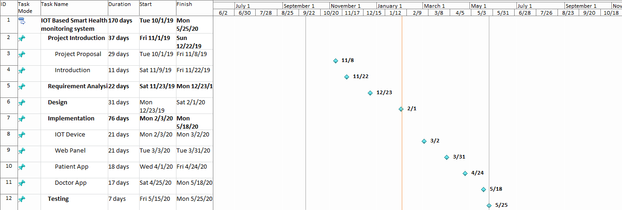

Slide 3
Project management
Project Plan(Gantt Chart)

Slide 4
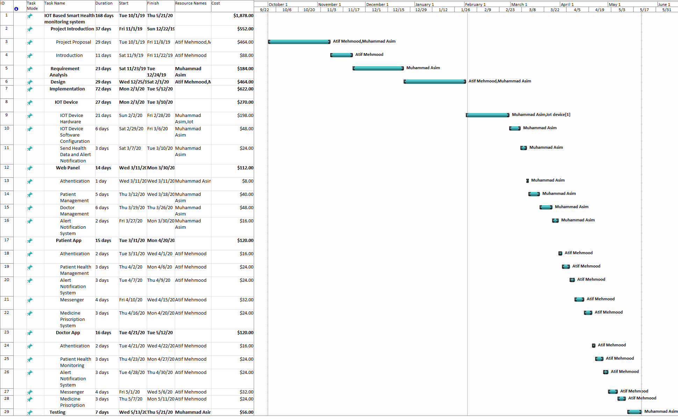

Slide 5
Project management
Resources Management

Slide 6
Project management
Risk Management

Slide 7
Risk Management
Risk management is about maximizing your chances of project success by identifying risks early on and planning how to manage them.
Some risk are described as:-
Activities are missing from scope Required activities are missing from scope definition.
Design is infeasible The design isn't possible, is excessively costly or doesn't support the requirements.
Delays to required infrastructure Delays to infrastructure such as hardware or software
Failure to integrate components The risk that product components will fail to integrate with each other.
Requirements are incomplete You can spot obvious holes in the requirements.
Delays to stakeholder approvals impact the project The risk that approval deadlines will be exceeded.

